Slide 1

Professional Practices (HUM-305)
SPRING SEMESTER 2026
By
Prof Engr Muhammad Raheel Iqbal Butt
Resource Person
Contact: +92 321 7433568
School of Computer & Information Technology
Beaconhouse National University, Lahore

Slide 2
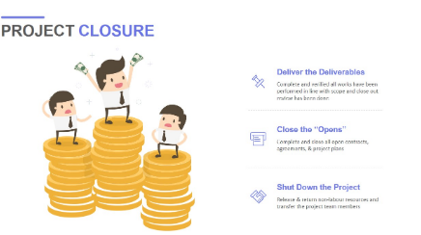

Slide 3
Chap 14 Terminating the Project
Presentation of projects
Project Closing
Support

Slide 4
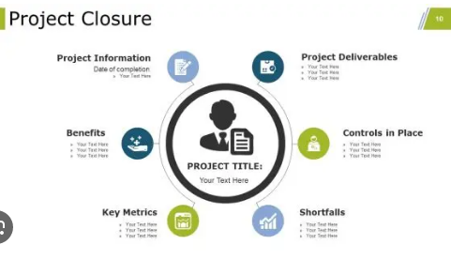

Slide 5
Project Overview & Presentation
Objective: Effectively communicate the project's value, journey, and final deliverables.
The "Elevator Pitch": Start with a 1-2 sentence summary of what the project achieved and its core value proposition.
Core Objectives: Highlight the primary goals established at the beginning and how they map to the final results.
Key Achievements: Use metrics and data. For example, “Delivered \(\frac{2}{3}\) weeks ahead of schedule” or “Increased operational efficiency by \(\$15\%\).”
Visuals & Demos: Include brief graphs, screenshots, or a live demonstration of the final product/deliverable.

Slide 6
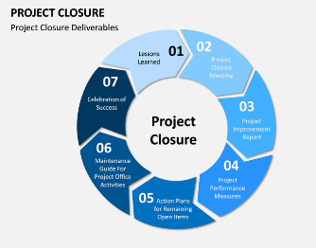

Slide 7
Project Journey & Highlights
Objective: Briefly showcase the work and how the team navigated the project lifecycle.
Timeline Overview: A high-level roadmap showing major milestones from kickoff to completion.
Challenges Overcome: Briefly mention 1-2 major hurdles (e.g., resource constraints, scope changes) and the solutions applied.
Value Delivered: Detail how the project impacts the end-user or business operations.

Slide 8
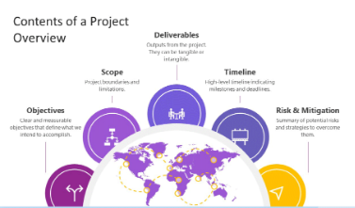

Slide 9
Project Closing – Formal Handover
Objective: Ensure all administrative and operational loose ends are tied up.
Deliverables Sign-off: Confirm that all agreed-upon deliverables have been transferred and accepted by stakeholders.
Asset Transfer: Outline the handover of project assets, including source code, design files, documentation, and licensing.
Financial Closure: Confirm the budget utilization and final billing sign-off.

Slide 10
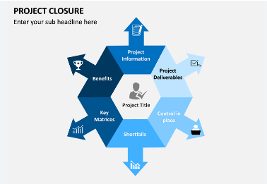

Slide 11
Project Closing – Post-Implementation Review
Objective: Evaluate project performance and extract actionable insights.
Success Metrics: Review the original Key Performance Indicators (KPIs) against the final project results.
Lessons Learned: Highlight what went well and identify specific areas for future process improvement.
Team Recognition: Acknowledge key contributors, stakeholders, and project team members.

Slide 12
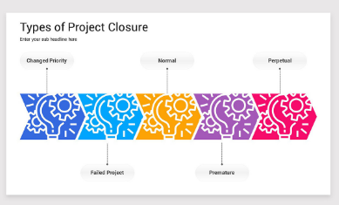

Slide 13
Transition to Support
Objective: Outline how the project will be maintained moving forward.
Handover Documentation: Ensure access to Standard Operating Procedures (SOPs), user manuals, and system architecture guides.
Support Model: Clearly define the transition from project mode to "Business as Usual" (BAU).

Slide 14
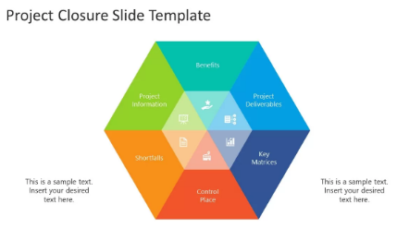

Slide 15
Support & Maintenance Strategy
Objective: Detail the ongoing support structure to guarantee long-term stability.
Support Tiers & SLAs:
Tier 1: Basic troubleshooting & FAQs.
Tier 2: Technical issue resolution.
Tier 3: Critical bug fixing/escalation with defined Service Level Agreements (e.g., (24 / 7) availability or response within 4 hours).
Communication Channels: Specify how users/clients can log tickets (e.g., Helpdesk Portal, dedicated email address, or ticketing system).
Maintenance Schedule: Outline planned downtime, update cycles, and routine check-ups.

Slide 16
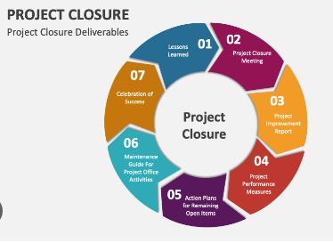

Slide 17
Continuous Improvement & Feedback
Objective: Establish a process for future enhancements and user feedback.
Feedback Loop: Detail how users can submit feature requests and suggestions for future iterations.
Version Control/Updates: Explain how future updates, patches, and upgrades will be deployed.
Q&A: Open the floor for stakeholder questions and discussion.

Slide 18
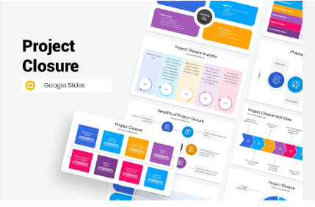

Slide 19


Slide 20


